Slide 1





Malaria funding request
Global Fund Grant Cycle 2024-27

Slide 2
Funding Request Development Process
Internal discussion to identify key strategies, challenges, priority areas & mapping of resources in Jan 2023.
Multi Stakeholder consultation meeting organized by ICCM in Feb 2023.
Selection and finalization of NGPR by ICCM in Mar –Apr 2023
Discussion on the activities among the PRs in Apr- May 2023
2 rounds of Diseases specific technical committee meeting May 2023
NG-PR Re-selection organized by I-CCM in Aug-23
3rd round of Diseases specific technical committee meeting held again in Aug-23

Slide 3
Augmenting the effort of Malaria elimination in the project states & districts by 2027, and providing an enabling environment to prevent re-establishment of malaria (aligned with National Strategic Plan 2023-27).
Goal for Malaria Funding Request (2024-27)
Objectives:-
Health System Strengthening & focused activities in high endemic areas;
Strengthening malaria surveillance involving all relevant stakeholders;
Strengthening of entomological units in the projects states to achieve malaria elimination;
Strengthening SBCC activities focused on high endemic areas;
Augment the process of sub- National malaria Elimination Certification in phased manner;
Conducting operational/interventional research.

Slide 4
Geographical Coverage
District wise mapping of project area
States | Total project districts | No of district with API >1 in 2021
7 NE states | Complete (110 dist.) | 8 (4MZ, 3 TR, 1ML)
Odisha | 19 | 6
Jharkhand | 13 | 1
Chhattisgarh | 16 | 7
Maharashtra | 1 (newly added) | 1
Total | 159 | 23
API <1
API >1
23 districts having API >1 in the year 2021 contributing 51.4% cases and 66.7% deaths

Slide 5
High Endemic Districts (based on 2021 data)
State | Districts | Total Blocks | High endemic blocks | Name of Districts with API >1
Chhattisgarh | 7 | 32 | 28 | Bastar, Bijapur, Dantewada, Kanker, Kondagaon, Narayanpur, Sukma
Jharkhand | 1 | 15 | 7 | West Singbhum
Odisha | 6 | 60 | 38 | Boudh, Kalahandi, Kandhamal, Koraput, Malkangiri, Rayagada
Maharashtra | 1 | 12 | 6 | Gadchiroli
Meghalaya | 1 | 4 | 3 | South Garo Hills
Mizoram | 4 | 38 | 26 | Lunglei, Mamit, Lawngtlai & Saiha
Tripura | 3 | 22 | 5 | Dhalai, Khowai, South Tripura
Total | 23 | 183 | 113
Note:- Out of 183 blocks; 113 are high endemic blocks with API>1

Slide 6
% Contribution of Population, Malaria Cases, Pf Cases and Deaths (2021) (compared to country total)
States | No of districts proposed | % Population | % Malaria cases | % Pf cases | % Deaths
N.E. States (7) | 110 | 3.6 | 11.6 | 15.6 | 18.9
Odisha | 19 | 1.9 | 15.4 | 22.1 | 12.2
Chhattisgarh | 16 | 1 | 17.6 | 24.4 | 41.1
Jharkhand | 13 | 1.3 | 7.3 | 8.1 | 0
Maharashtra | 1 | 0.1 | 7.6 | 10.5 | 8.9
Project Areas- 7 NE States+ JCOM (proposed) | 159 | 7.9 | 59.5 | 80.7 | 81.1

Slide 7
Comparison Existing vs New Malaria Grant under Global Fund Grant 65m (INR 524.8 crore)
NG- PRs shortlisted by screening committee
TCI Foundation
Plan India
PCI India
WJCF
Existing NG-PR
TCI Foundation
1 USD= INR 80.74186

Slide 8
Activities proposed for NCVBDC……. (1/2)
Modules |  | USD m | INR Cr
Vector Control | LLINs- Qty 10.67 m as per the replenishment cycle for Madhya Pradesh | 29.80 | 240.61
 | Entomologists Training- PAN India and Lab Technicians training at RoHFW | 0.63 | 5.09
 | Insecticide Resistance Monitoring | 0.06 | 0.47
 | Development of SBCC & IEC Package | 3.07 | 24.79
RSSH: Monitoring & Evaluation Systems | House hold Surveys and research studies (Therapeutic Efficacy Studies, Insecticide Resistance Studies, Longitudinal study) | 3.72 | 30
Program Management | National Program Management Unit for monitoring & capacity building at Centre & State | 3.02 | 24.4
 | Vehicles Procurement- 104 vehicles against replacement of IMCP-3 (2015-17) | 1.42 | 11.47
 | Inter State Cross Border Meetings | 0.16 | 1.26
RSSH: Community Systems Strengthening | Focused Activities through engagement of 6 NG-SRs in high endemic districts | 3 | 24.22
RSSH: Health Product Management Systems | Development & Implementation of e-LMIS (Logistic Management Information System) | 3 | 24.22
 | Contd-

Slide 9
Activities proposed for NCVBDC……. (2/2)
Externally Aided Component (EAC) support to project states under NHM |  | USD m | INR Cr
Vector Control | Consecutive & Concurrent supervision of IRS- High endemic areas | 1.95 | 15.76
RSSH/PP: Human resources for health (HRH) and quality of care | Block MTS for 7 NE States | 1.20 | 9.70
Program Management | State Review Meetings- Quarterly Regional Review Meetings- every 4 months | 0.63 | 5.15
 | Mobility Support for State HQs, District HQs & Block level | 2.87 | 23.15
 | District VBD Consultants & DEO for 7 NE states | 3.71 | 29.97
 | AMC- Motor Bikes, Vehicles, Microscopes etc | 2 | 16.15
 | Grand Total | 60.24 | 486.41

Slide 10
Activities for NG-PR (TCIF)
Modules | Activities budgeted | USD-m | INR-cr
RSSH: Monitoring & Evaluation | Sub-national Malaria Certification | 0.59 | 4.76
Vector Control | Strengthening of Entomological Zones | 0.06 | 0.51
 | Strengthening of labs | 0.67 | 5.45
RSSH: Community Systems Strengthening | Procurement of tablets & other logistic | 0.06 | 0.44
Program Management | National Review Meetings | 0.32 | 2.56
 | Capacity Building of various health cadres at district & block level | 1.69 | 13.61
Program Management | Other PMU & Office Related Cost of NG-PR | 1.37 | 11.08
 | Grand Total | 4.76 | 38.41

Slide 11
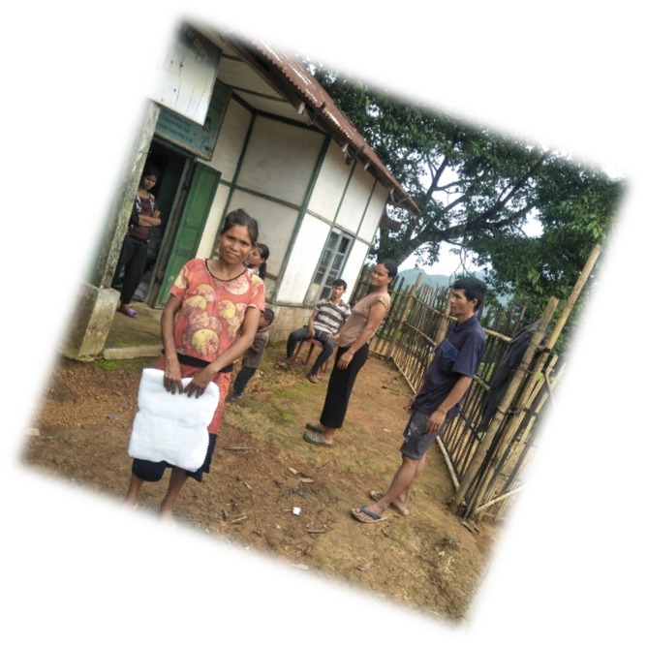
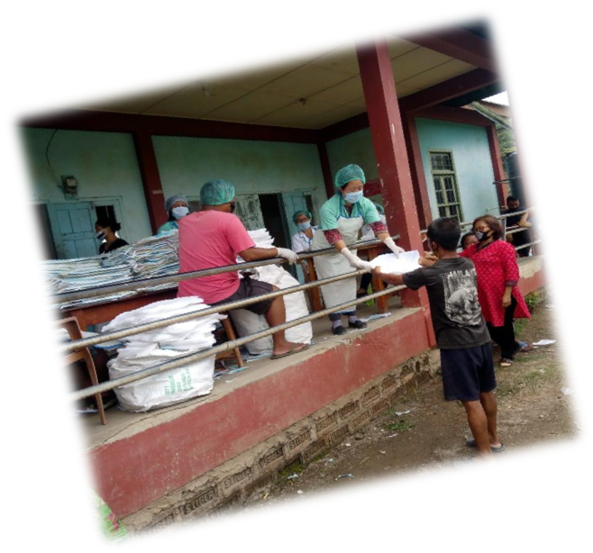
THANK YOU

